Slide 1
The Clever Eagles
Omkar Ranadive
Anupam Tripathi
Nikita Raut

Slide 2
Theme
Understanding the impact and analyzing the trends after the CPDB went public. Our project compares and analyzes the trends before release of CPDB (before 2015) and compares it with the trends observed after release of CPDB (from 2015 onwards).

Slide 3
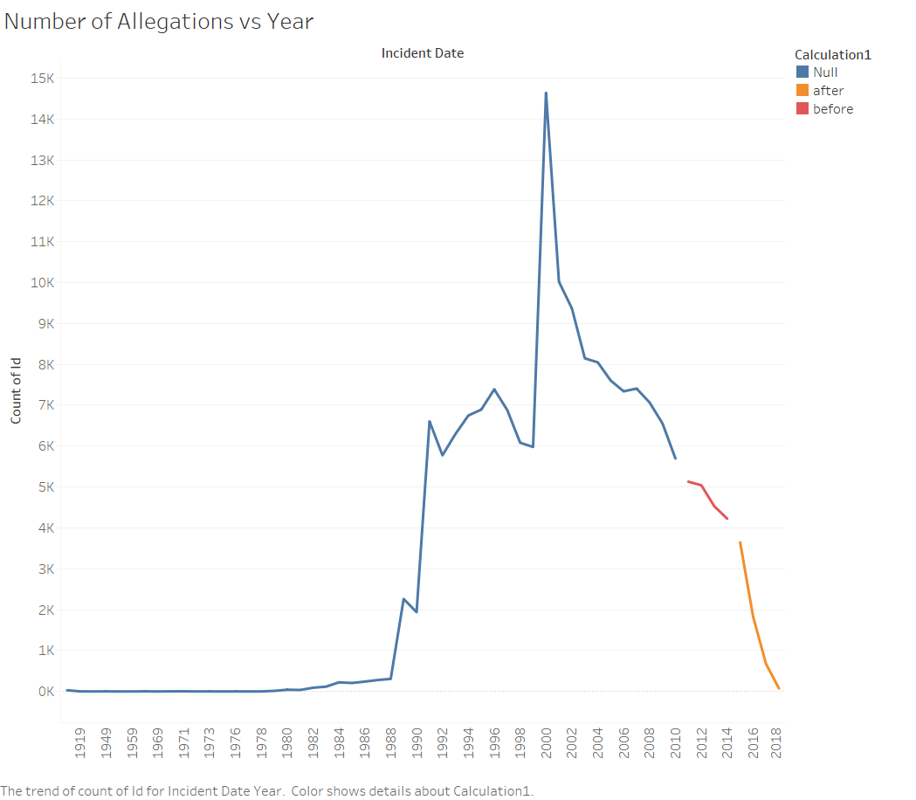
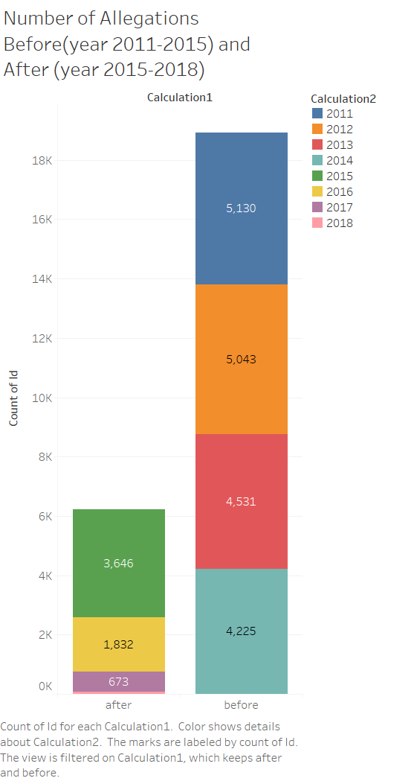
Visualizing whether there has been any decrease in allegations after the CPDP data has gone public with the help of line charts (Allegation vs Time) and histograms (Before vs After)
Notes:
The number of allegations have surely gone down since 2015.
The graph on the right shows the distribution of the data year wise. It would be unfair to compare the data of all the previous years to the 4 years since the data has gone public since the distribution is not even. Normalizing would not be a good idea since the years before 2000 are hardly contributing to the data. Therefore in the graph on the left, we have compared 4 years before vs 4 years after the data went public. Before was significantly higher.

Slide 4
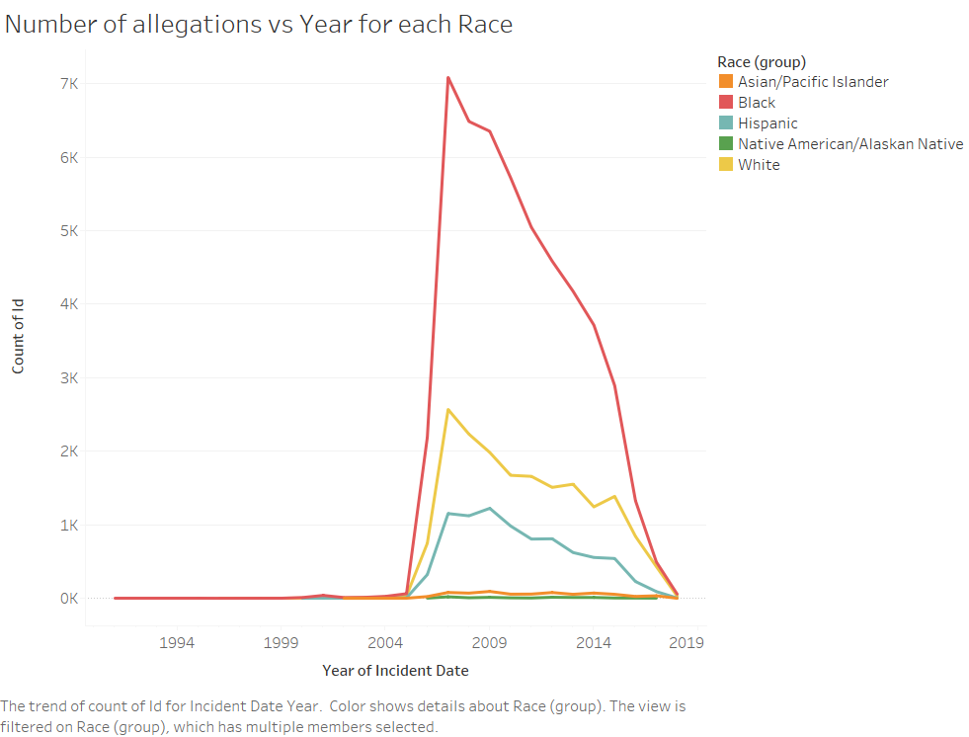
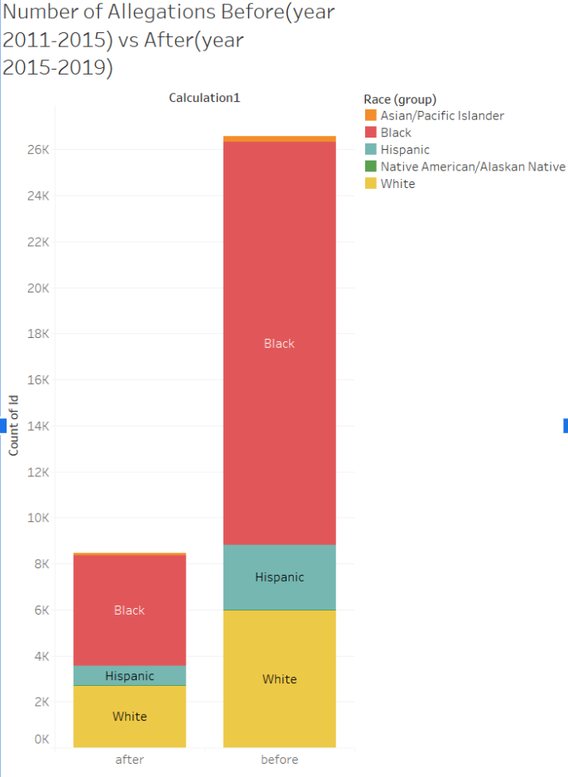
Visualizing the trends in the race of victim affecting number of allegations
Notes:
We were expecting the highest of the peaks to be at 2015, however, we found that the highest peaks are at 2007. After analyzing the reason behind this we found that there can be t2o reasons for this:
In 2007 as bonds case moved forward a request was made to lift the protective order on the grounds that it withheld public information from the public.
IPRA replaced OPS in 2017
Also the 2nd highest peak is at 2015, which can again have two reasons:
CPDb went public
COPA replaced IPRA
2)

Slide 5
2007
2015
COPA replaces IPRA
IPRA replaced OPS
Request for making data public on the Bond case
Data goes public for the first time.

Slide 6
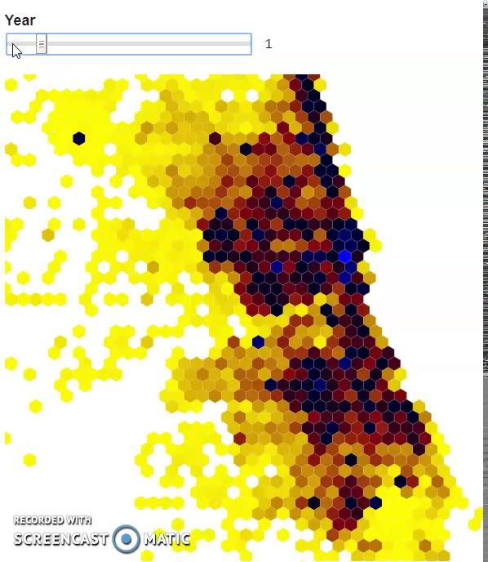
Heat map of areas in which the allegations take place while also considering the date.
https://observablehq.com/@rautnikita77/heatmap
0: Allegation of years before 1950
1: Allegation of years between 1950 - 2000
2: Allegation of years between 2000 - 2003
3:Allegation of years between 2003 - 2006
4:Allegation of years between 2006 - 2009
5:Allegation of years between 2009 - 2012
6:Allegation of years between 2012 - 2015
7:Allegation of years between 2015 - 2018
8:Allegation of years between 2018 - present

Slide 7
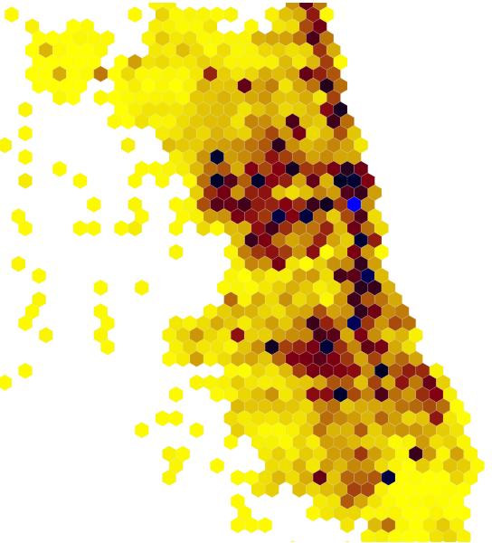
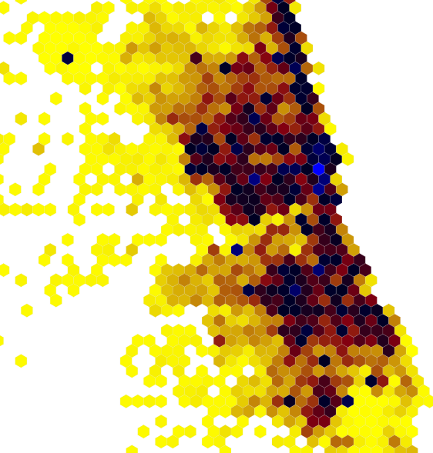
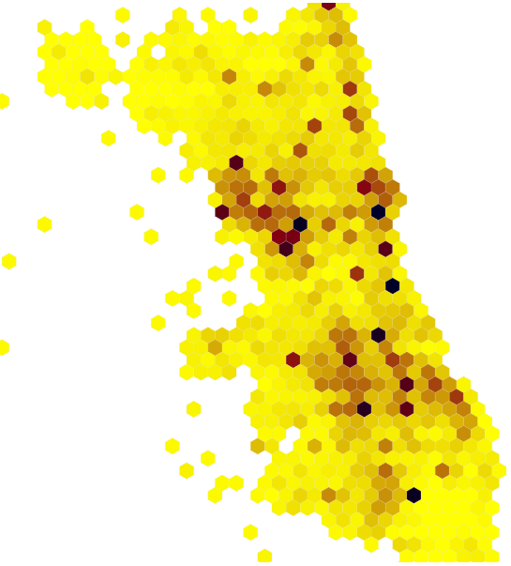
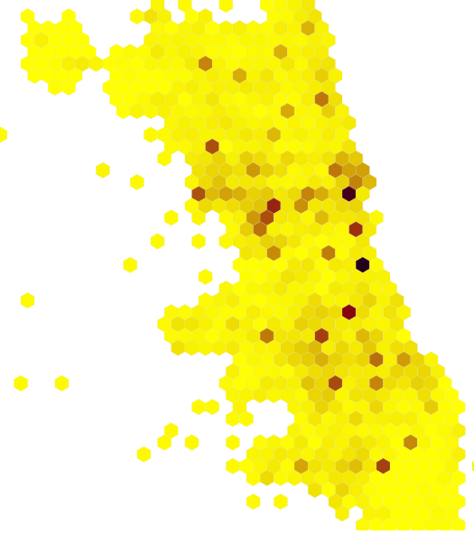
Highly targeted areas remain same
1950 - 2000 2000 - 2003 2012 - 2015 2015 - 2018
Notes:
There are some areas were the hexagons are very dark for most of the intervals of years signifying spots where these misconducts are very common. It would have been interesting to analyse officers that were assigned to these areas during these particular intervals of time. We can see that highly are targeted areas remain same even after cpdb went public. We also found some have been constant to some areas over the years eg: area with beat id 261 had officer Michael Clifton had incidents through the years 2006 - 2016. Area with beat id 215 had officer Paul Major 2000-2013.
The areas: beat_id

Slide 8
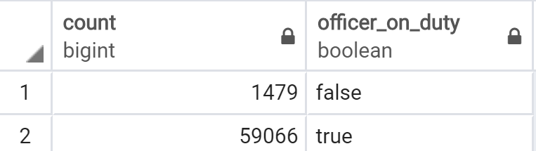
How many incidents were carried out by off-duty cops? (Before 2015)

Slide 9
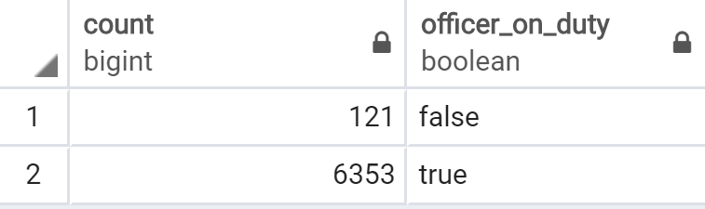
How many incidents were carried out by off-duty cops? (After 2015)
Notes:
The ratio hardly changes before and after the data went public.

Slide 10
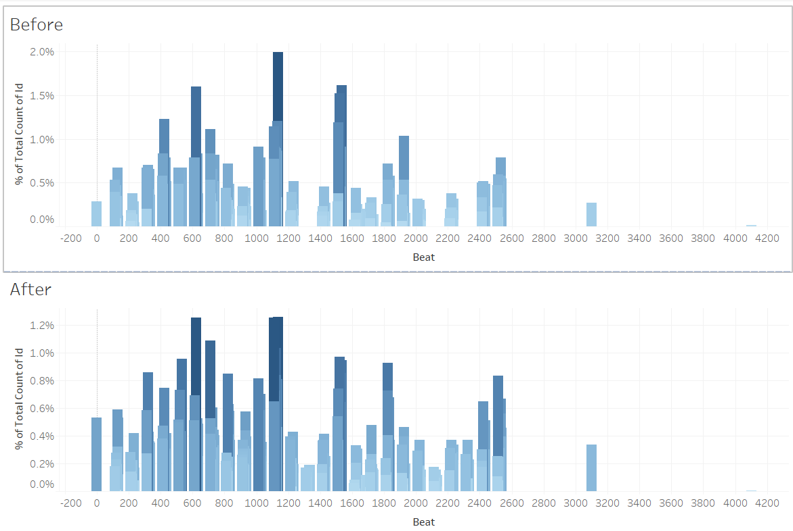
Normalized count of off duty officers before and after data going public per beat.
Distribution remains similar.
Notes:
Relative distribution remains the same. So, location plays a big factor in off duty cop incidents.

Slide 11
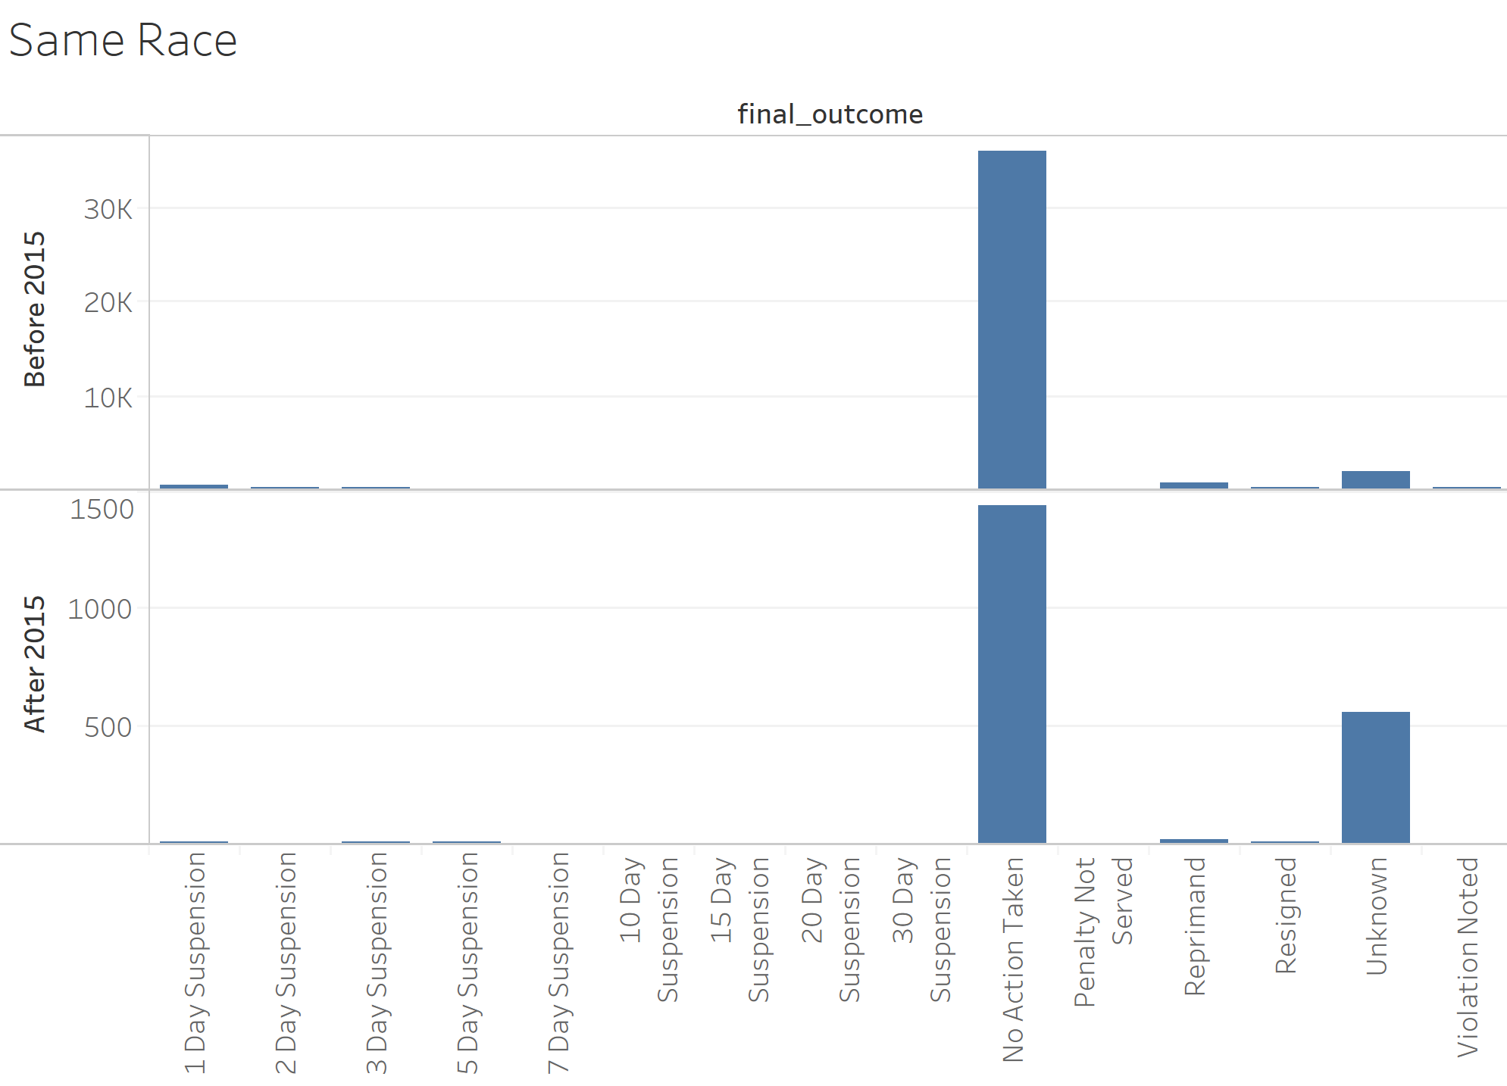
Does the investigator’s race affect the punishment given to the offending officer?

Slide 12
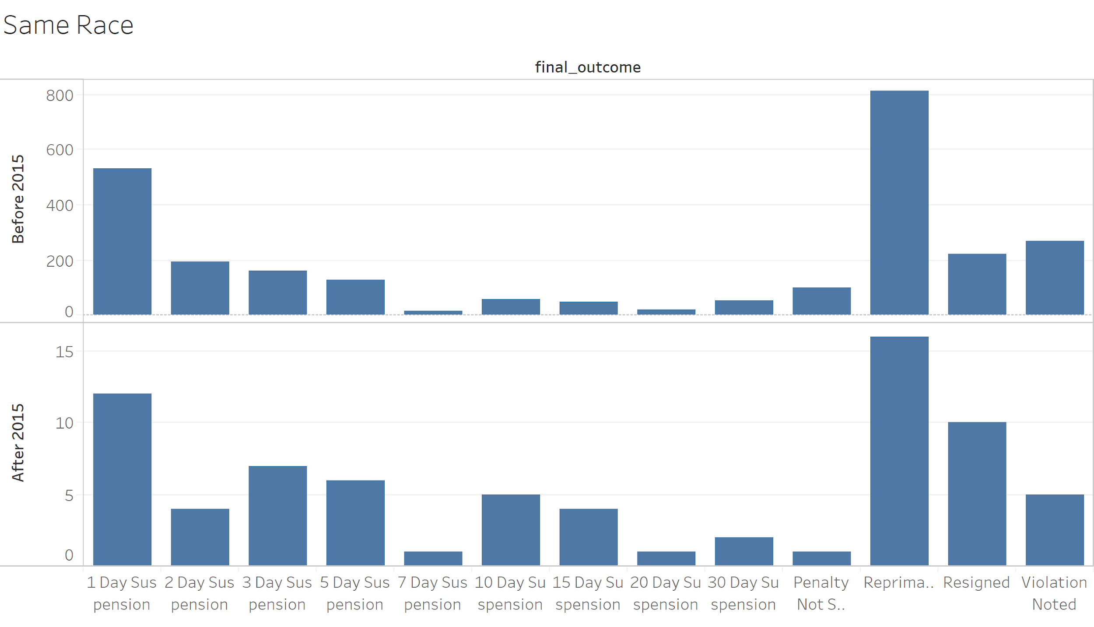

Slide 13
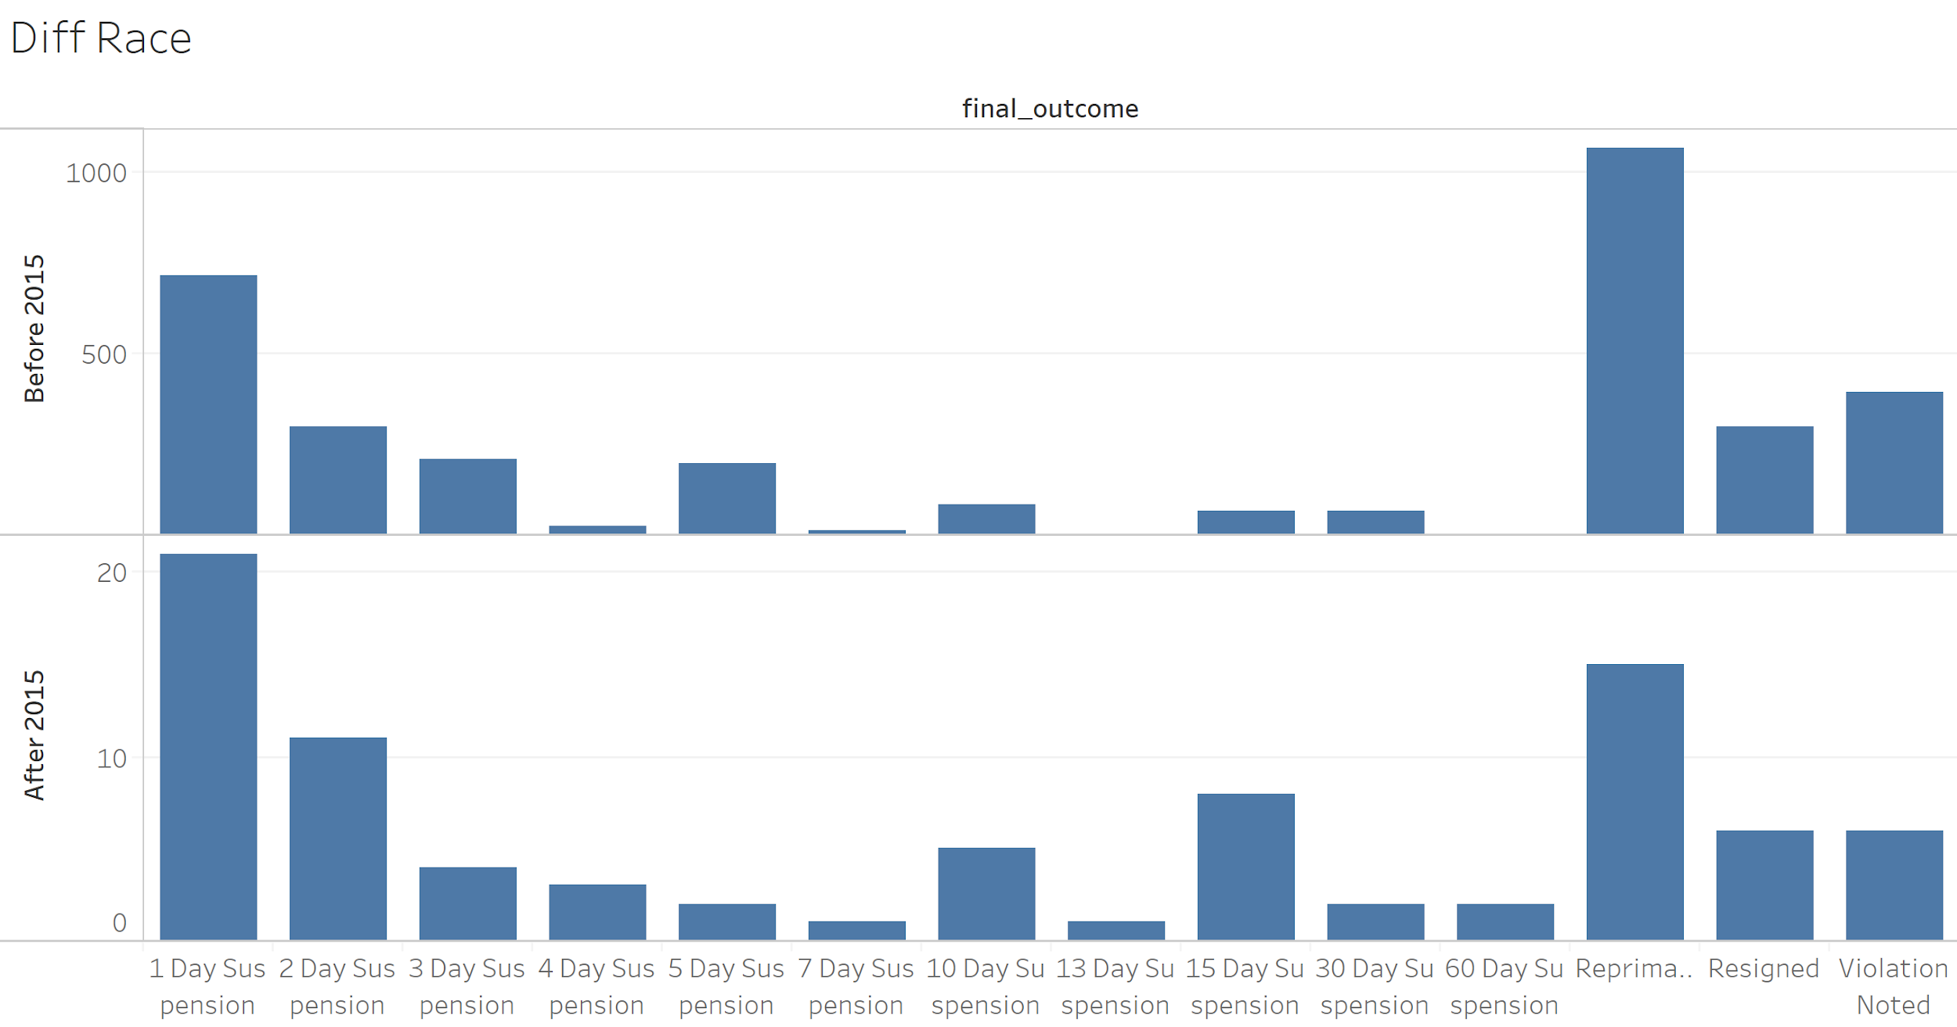
Notes:
The punishments are getting stricter in general. There are more punishments with 15,30,60 day suspension periods in both same race and diff races. A good thing!

Slide 14
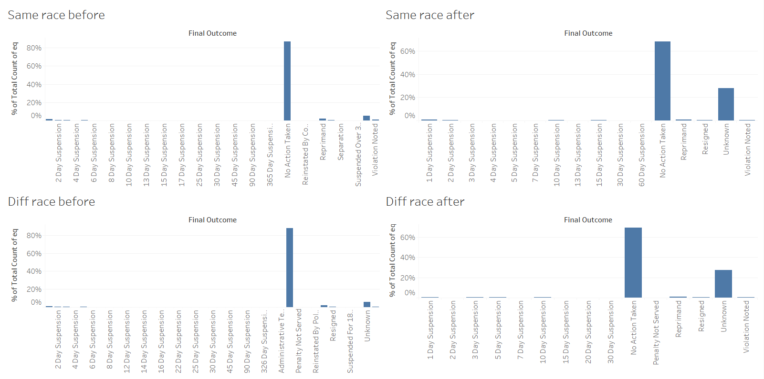

Slide 15
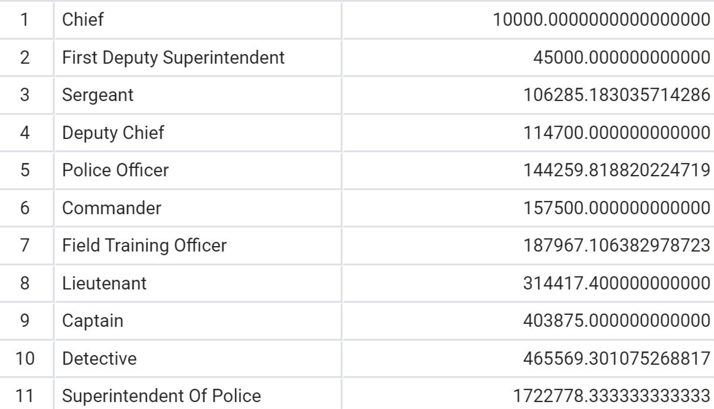
What is the normalized settlement amount per officer rank (Before 2015) ?
Notes:
We performed the ranking based on the number of officers of that rank. It still works as there are no allegations against the wrongly ordered ranks. (Ex - Superintendent’s chief of staff)

Slide 16
What is the normalized settlement amount per officer rank (Before 2015) ?
Lower ranked officers have higher settlement average
Police Officers and Superintendent of Police are outliers
A large sum of settlement average belongs to the Terry Hillard

Slide 17
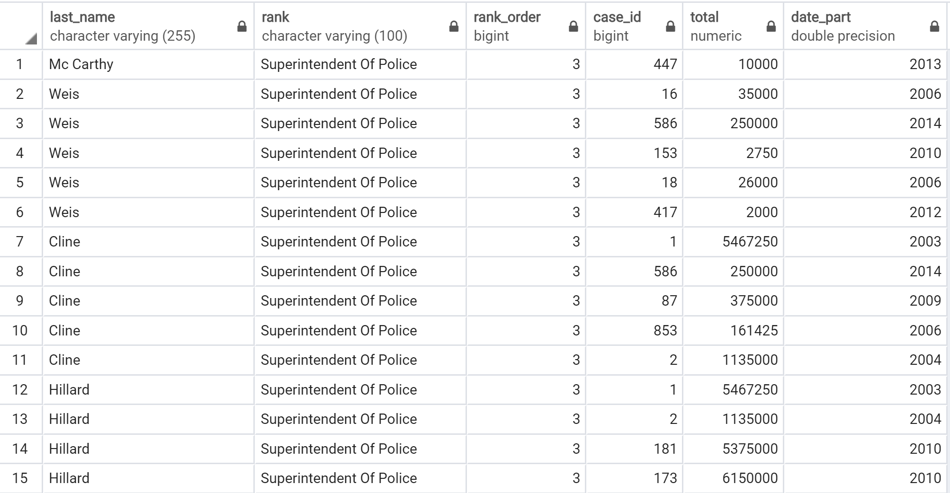

Slide 18
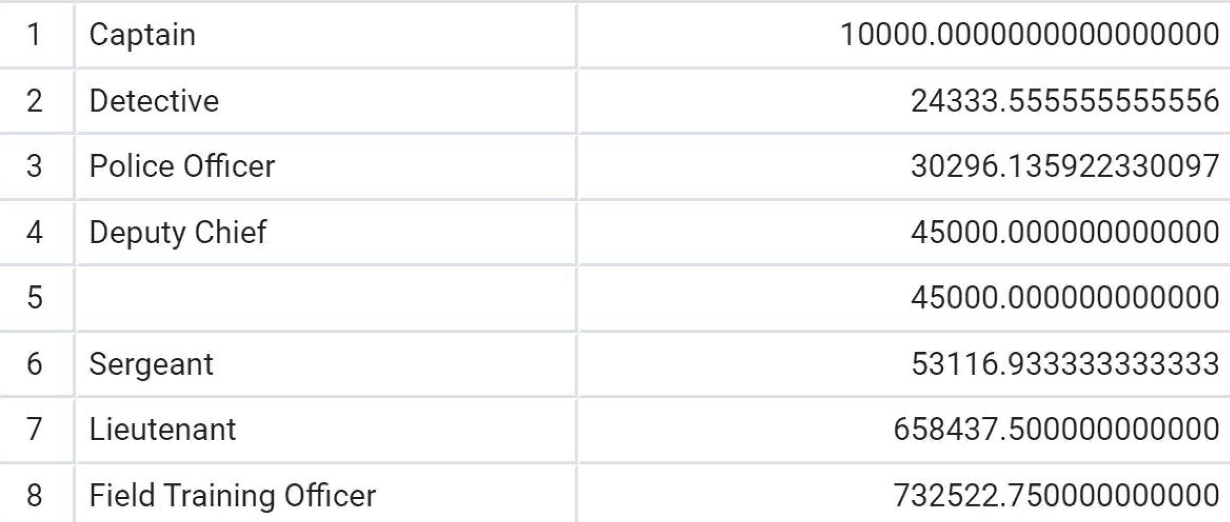
Normalized settlement amount after 2015
Notes:
Average settlement amount has gone down after 2015

Slide 19
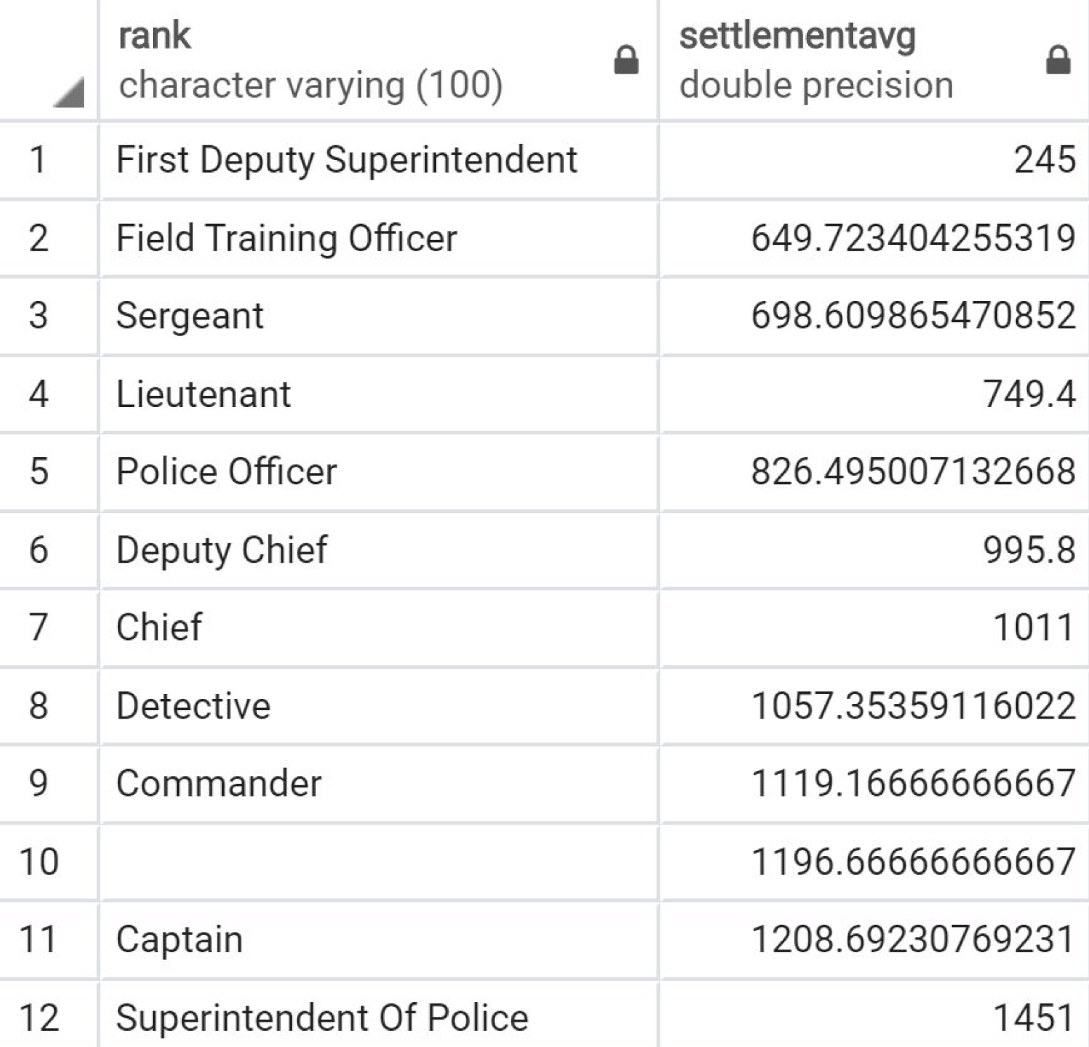
Average duration of cases per officer rank
(Before 2015)
Notes:
Lower ranked officers take longer to settle cases. Superintendent of Police is an outlier.

Slide 20
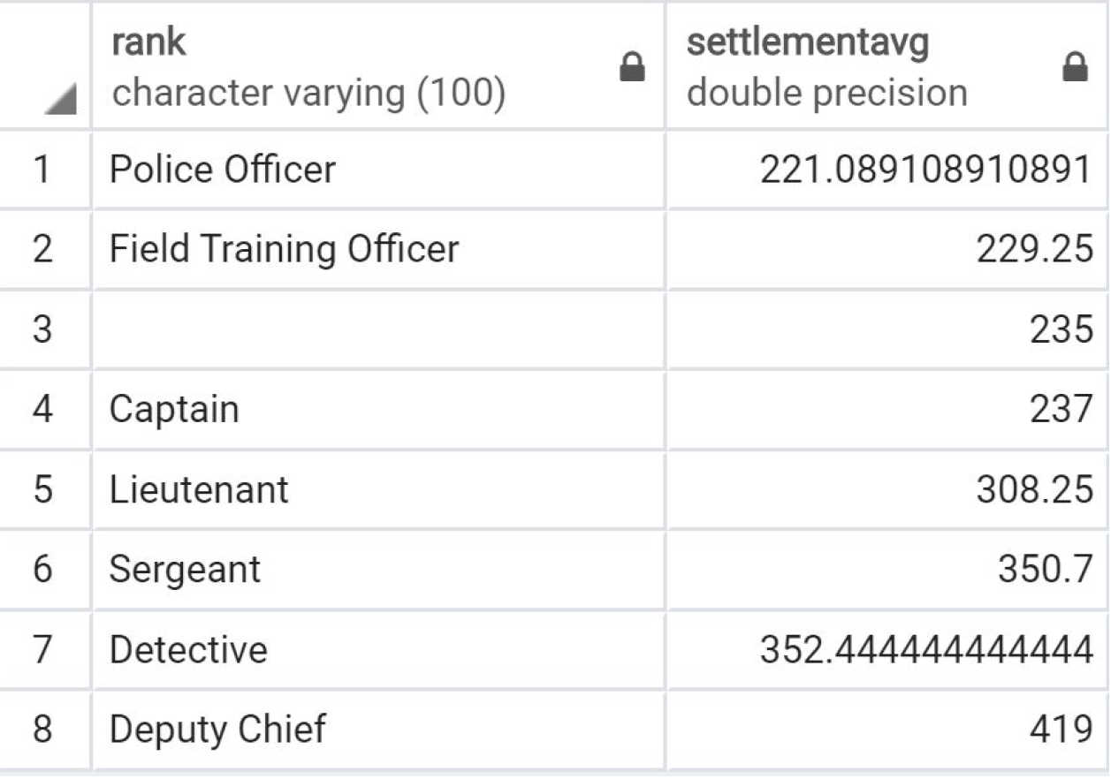
Average duration of cases per officer rank
(After 2015)
Notes:
No notable trend in data but the cases seem to be getting settled faster.

Slide 21
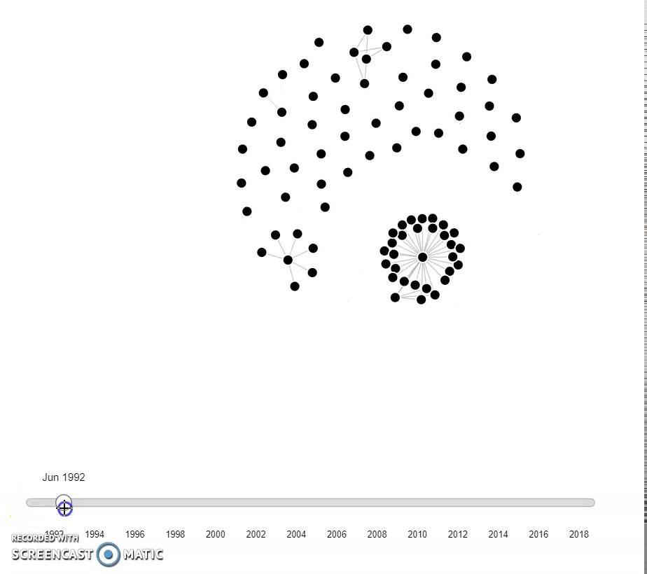
Graph Analytics: Co-accusal Network

Slide 22
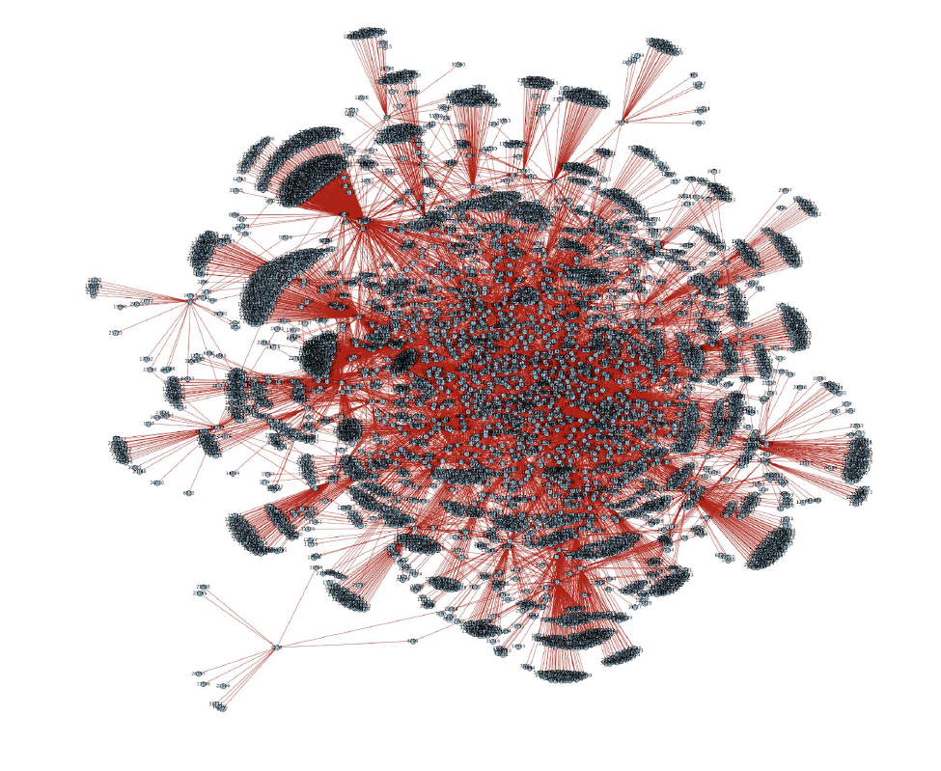
Graph Analytics: Co-accusal Network (Before 2015)

Slide 23
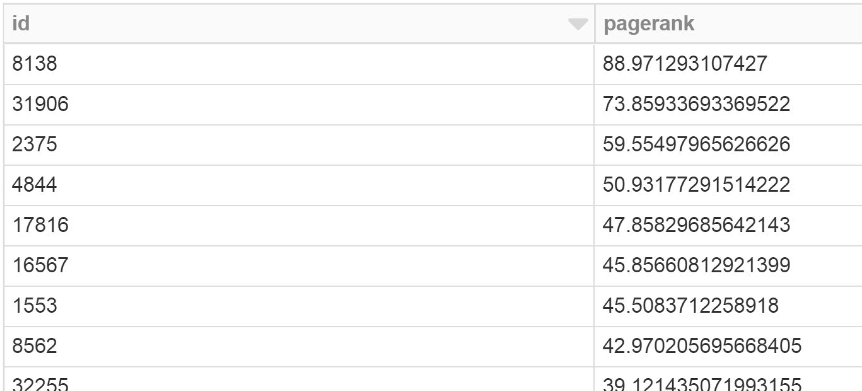
Graph Analytics: Co-accusal Network (Before 2015)
Officer identified as most important node via Page Rank algorithm - Glenn Evans

Slide 24
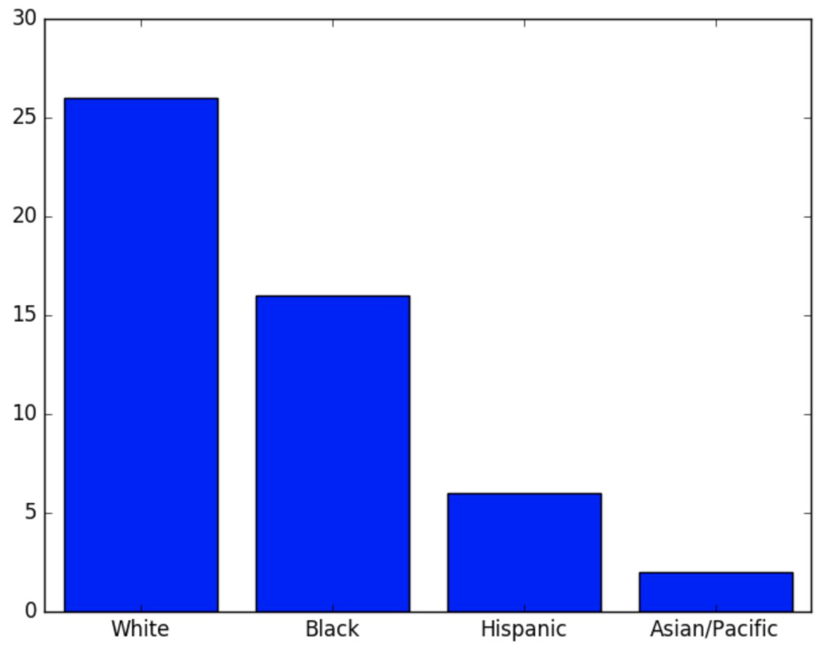
Graph Analytics: Co-accusal Network (Before 2015)
Top 50 officers (by pagerank) segregated by race
Normalized results:
Asians = 0.67
Hispanic = 0.437
White = 0.553
Black = 0.441
Notes:
2 out of the 3 Asian officers were in top 50

Slide 25
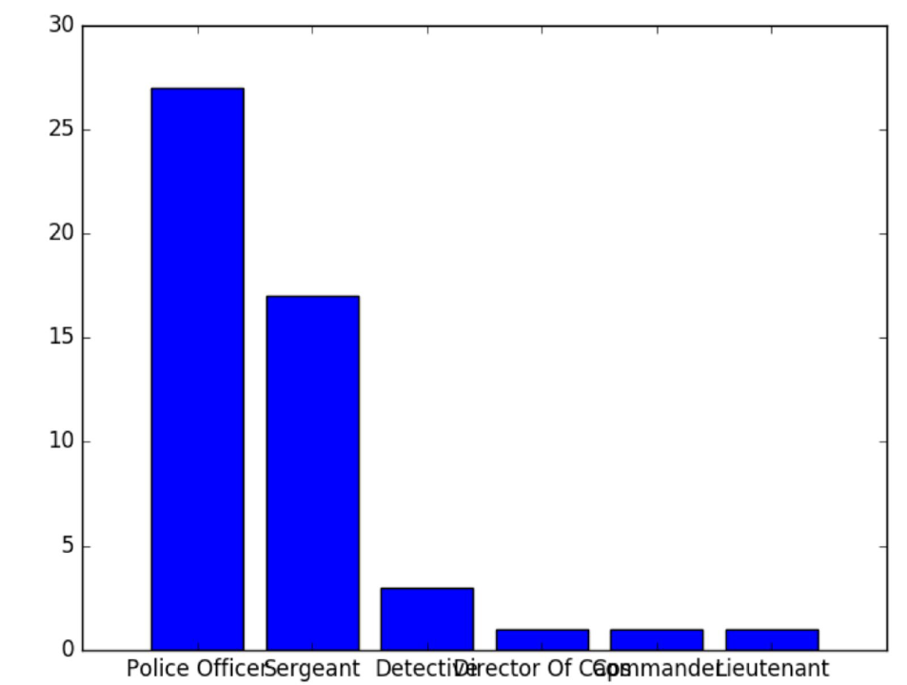
Graph Analytics: Co-accusal Network (Before 2015)
Top 50 officers (by pagerank) segregated by rank
Normalized results:
Director of Caps = 1
Sergeant = 0.77
Police officer = 0.442
Detective = 0.375
Commander = 0.5

Slide 26
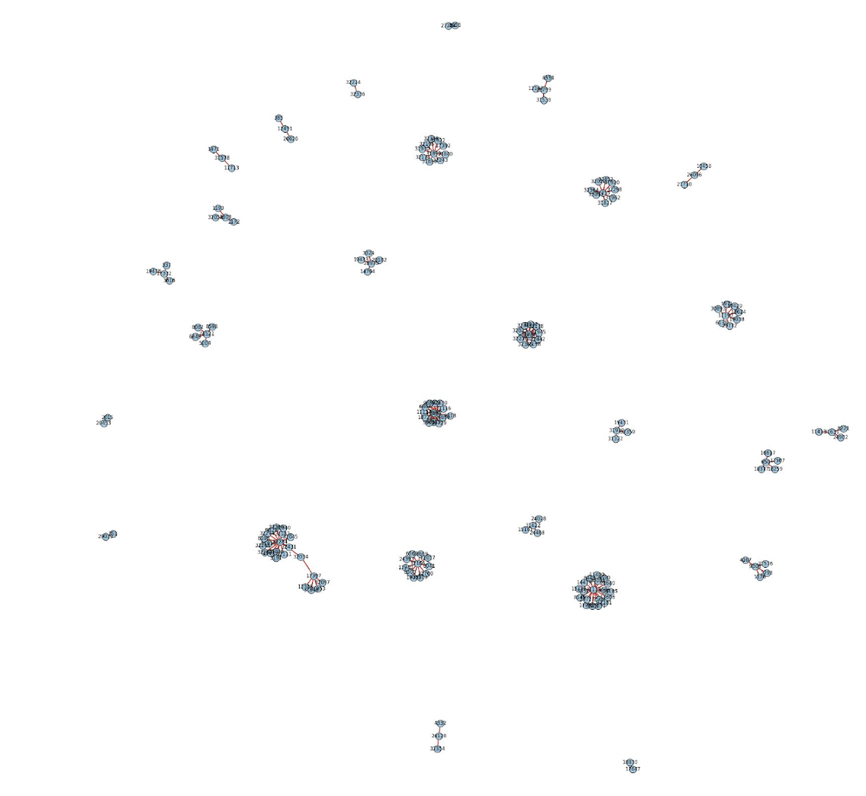
Graph Analytics: Co-accusal Network (After 2015)

Slide 27
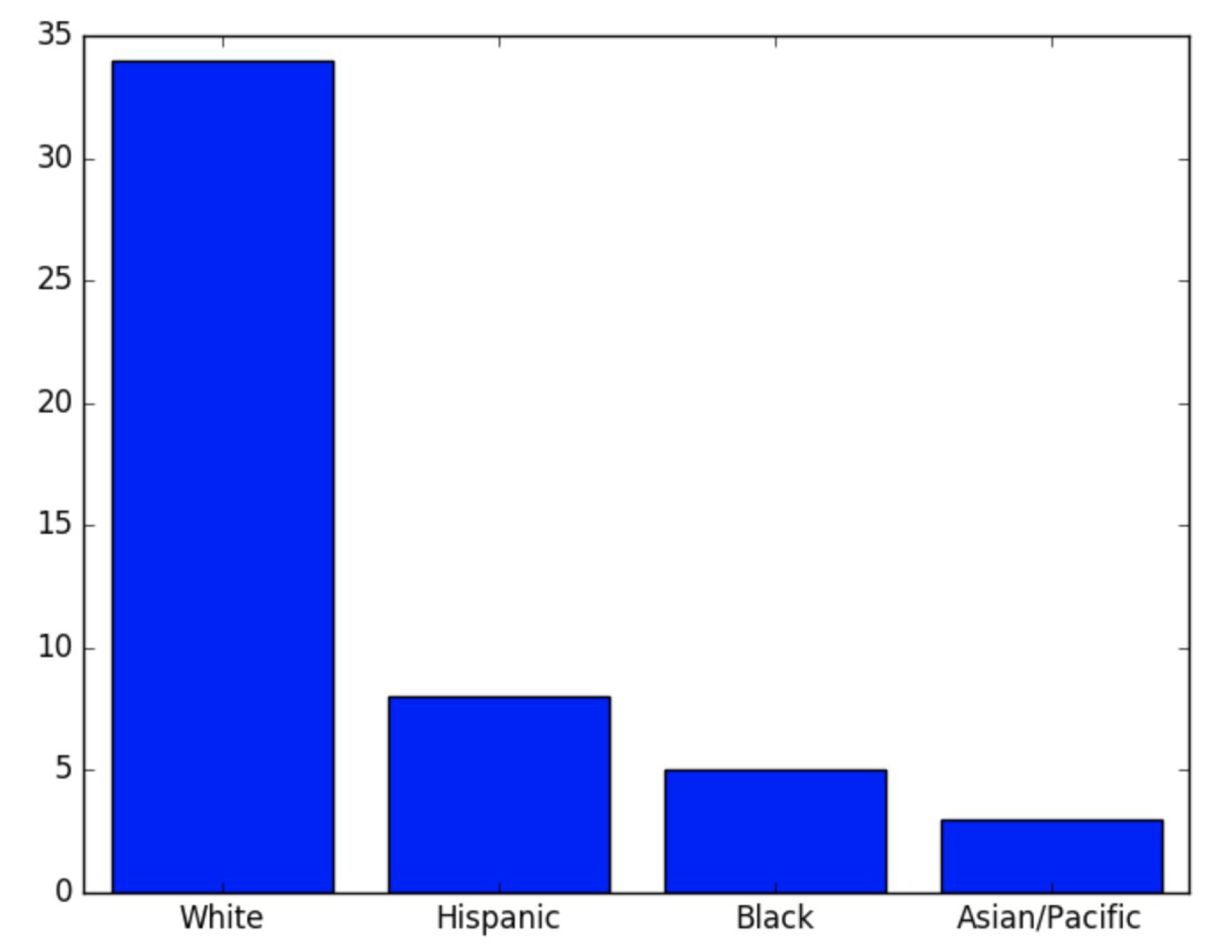
Graph Analytics: Co-accusal Network (After 2015)
Top 50 officers (by pagerank) segregated by race
Normalized results:
White = 34/47 = 0.72
Hispanic = 8/16 = 0.5
Black = 5/34 = 0.147
Asian = 3/3 = 1
Notes:
High number of normalized Asian count

Slide 28
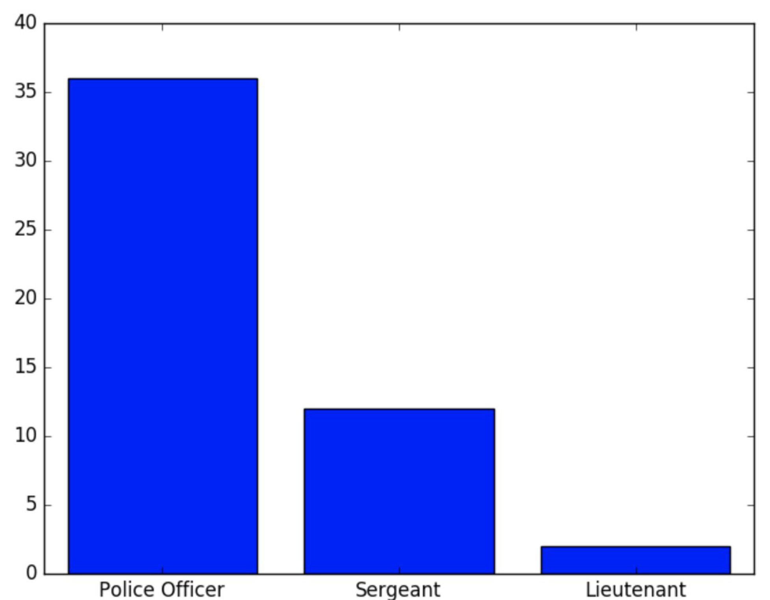
Graph Analytics: Co-accusal Network (After 2015)
Top 50 officers (by pagerank) segregated by rank
Normalized results:
Police Officer = 0.59
Sergeant = 0.54
Lieutenant = 0.6
Notes:
Only 3 ranks in top 50 after 2015. The Sergeant one is again significant even after 2015.

Slide 29
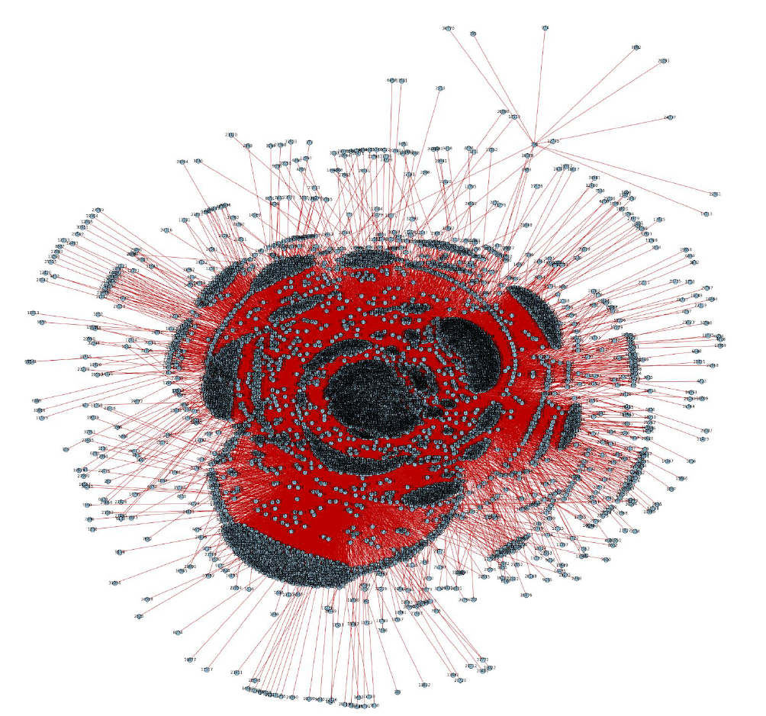
Graph Analytics: Officers linked based on same allegation category (Before 2015)

Slide 30
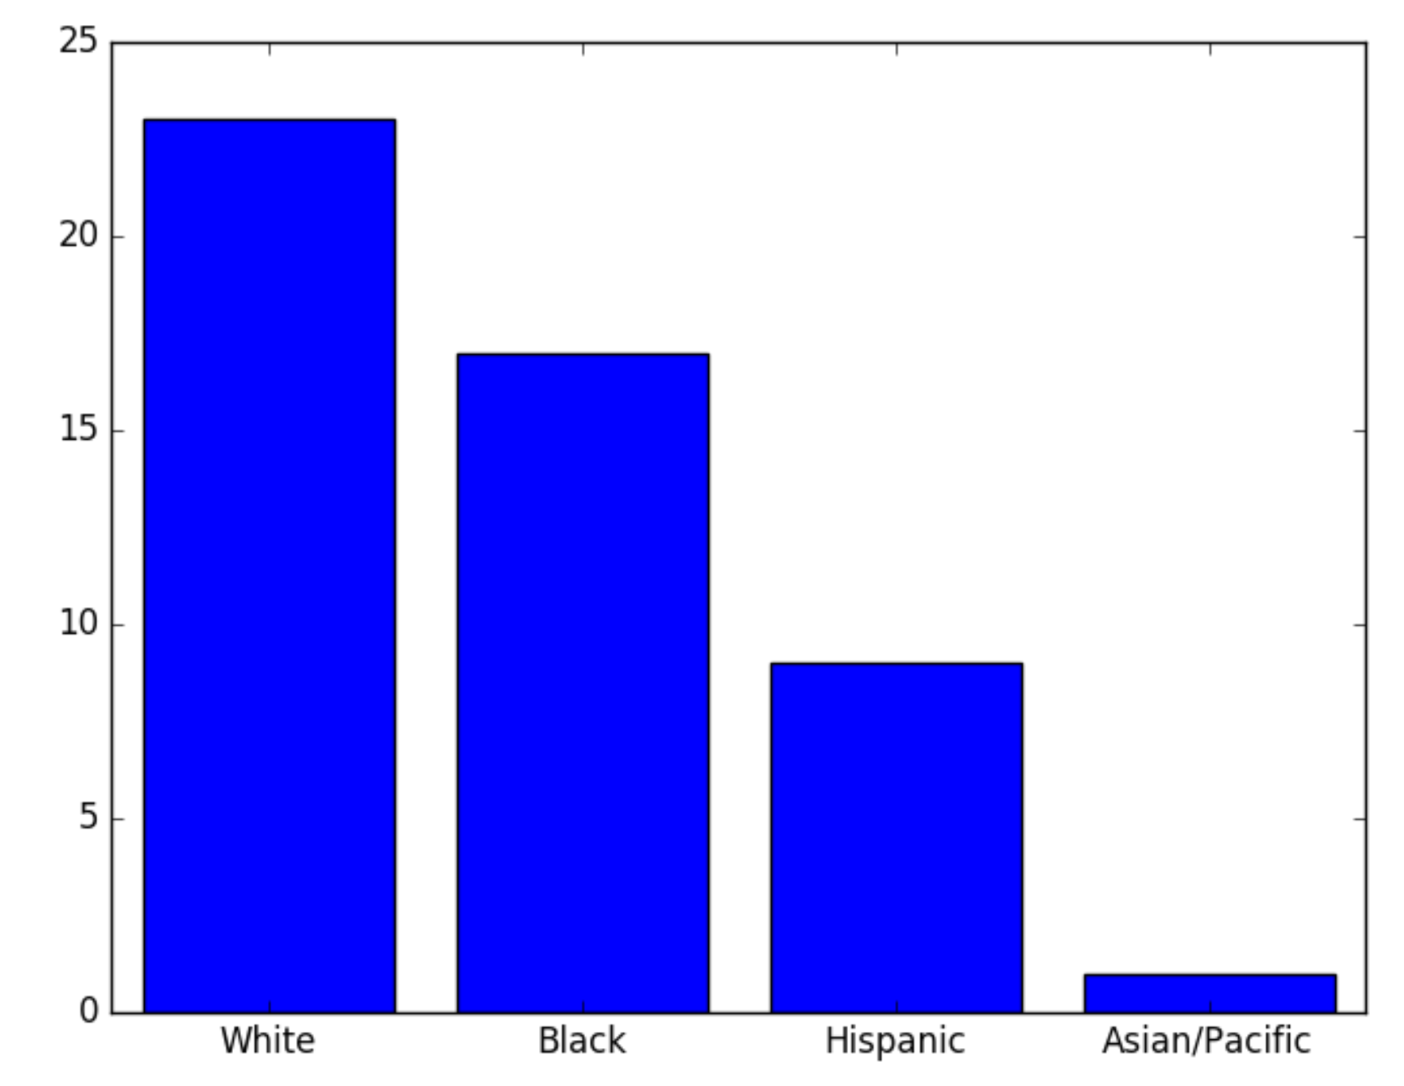
Graph Analytics: Officers linked based on same allegation category (Before 2015)
Top 50 officers (by pagerank) segregated by race
Normalized count:
White: 23/47 = 0.489
Black: 17/34 = 0.5
Hispanic: 9/16 = 0.562
Asian: 1/3 = 0.33
Notes:
So, the Asian race doesn’t seem to be a significant factor in terms of allegation category but was significant in terms of co-accusal network.

Slide 31
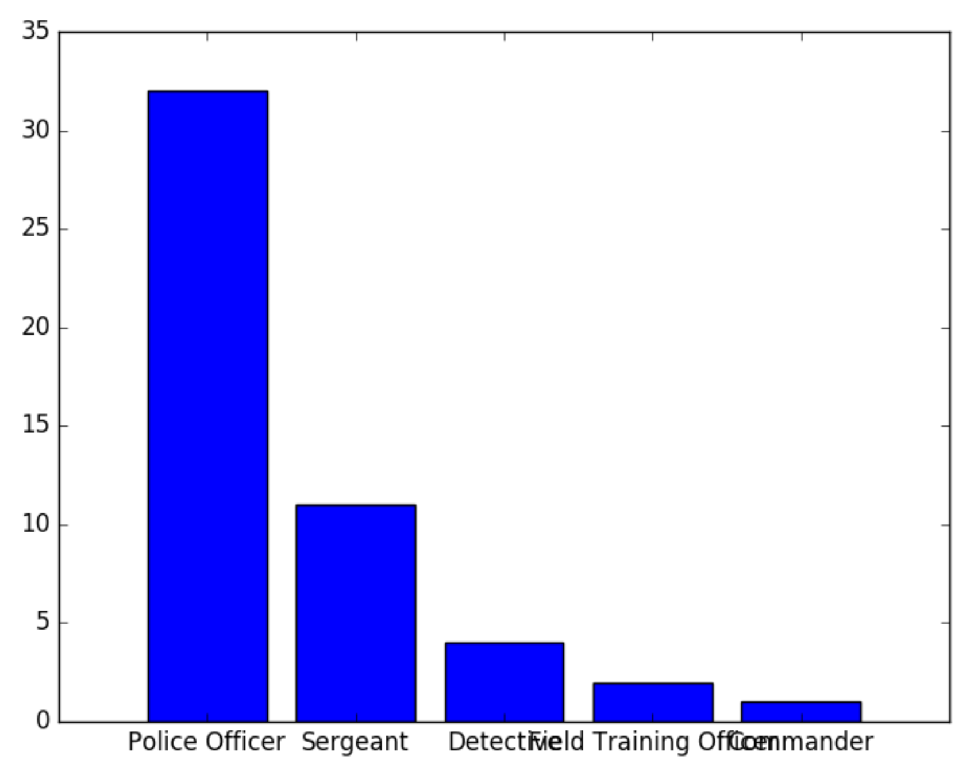
Graph Analytics: Officers linked based on same allegation category (Before 2015)
Top 50 officers (by pagerank) segregated by rank
Normalized count:
Police officer = 0.524
Sergeant = 0.5
Detective = 0.5
Field Training Officer = 0.66
Commander = 0.5
Notes:
Polic officers and field training officers seem to be prominent ranks when it comes to allegation category

Slide 32
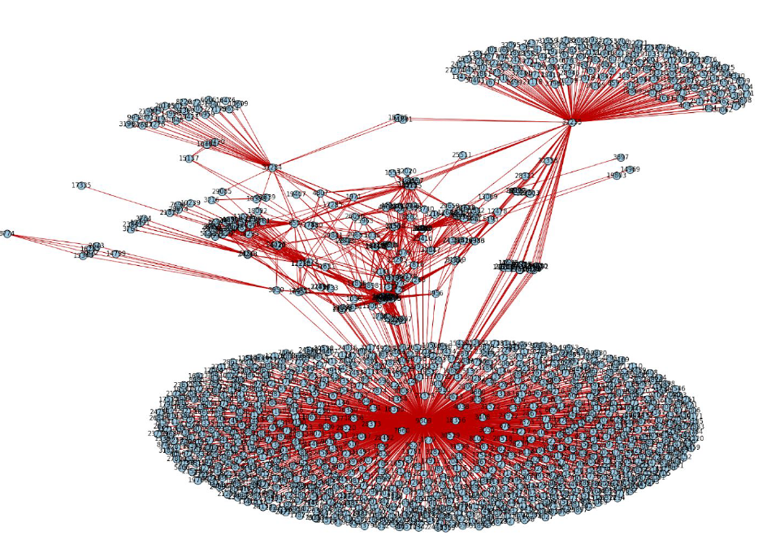
Graph Analytics: Officers linked based on same allegation category (After 2015)

Slide 33
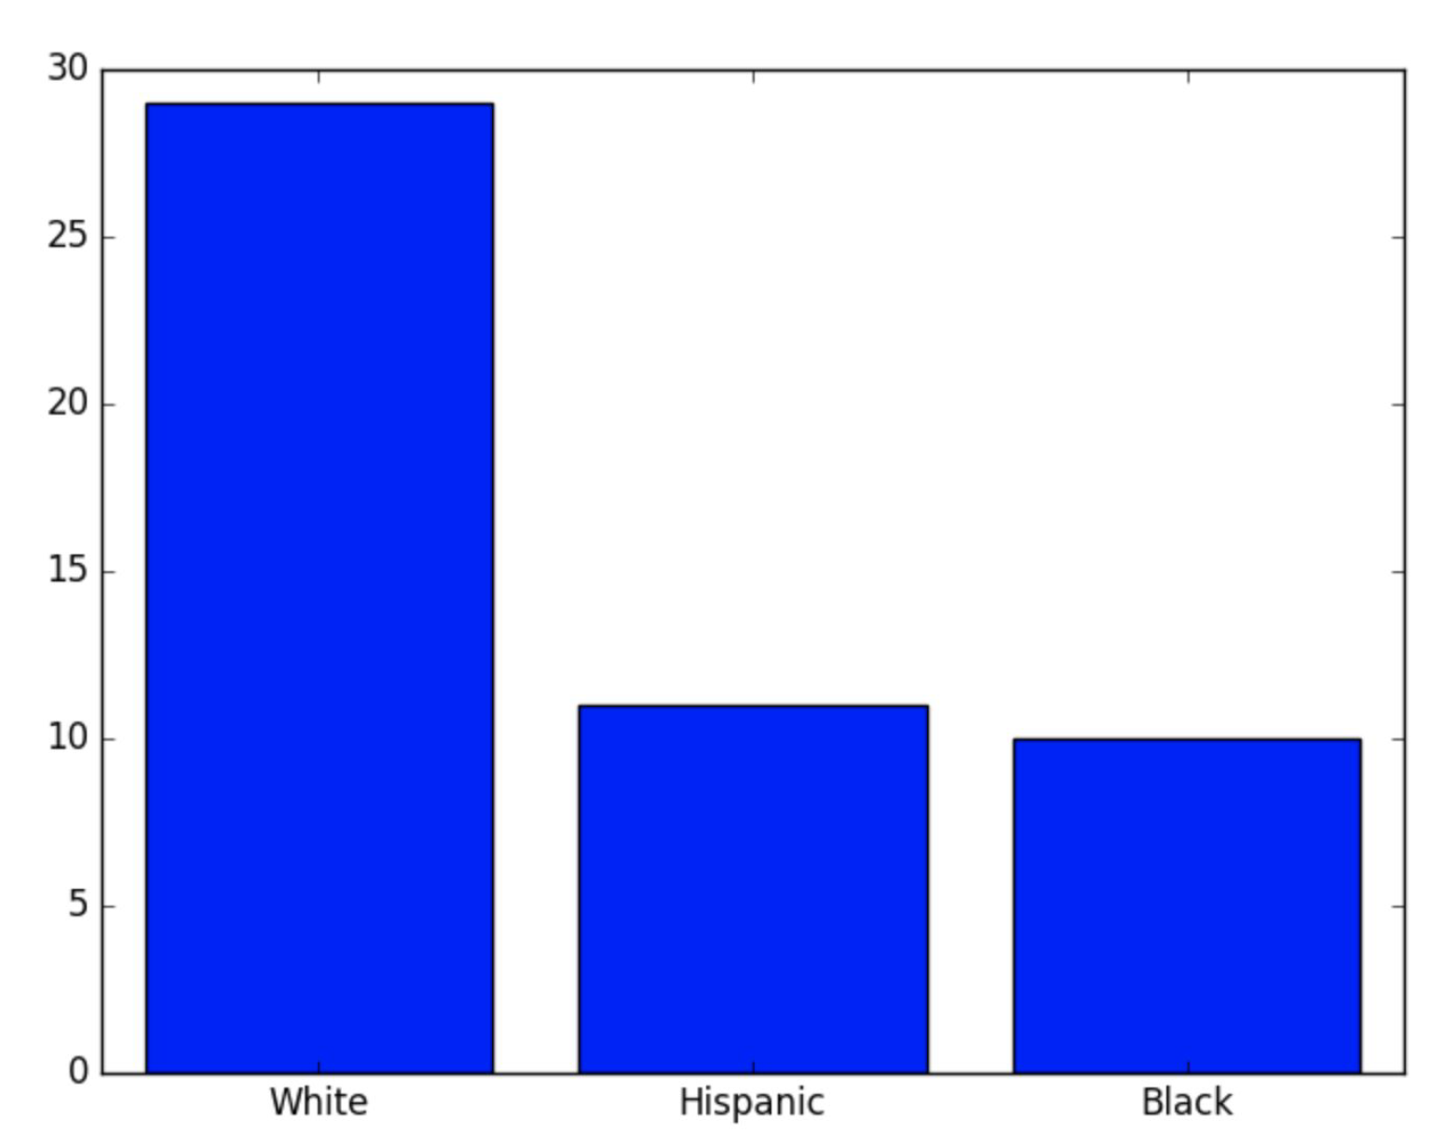
Graph Analytics: Officers linked based on same allegation category (After 2015)
Top 50 officers (by pagerank) segregated by race
Normalized count:
White: 29/47 = 0.617
Hispanic = 11/16 = 0.687
Black: 10/34 = 0.294
Notes:
After 2015, the Asian category is not present in the top 50 set. Also, yet again the Hispanic’s had the highest normalized count

Slide 34
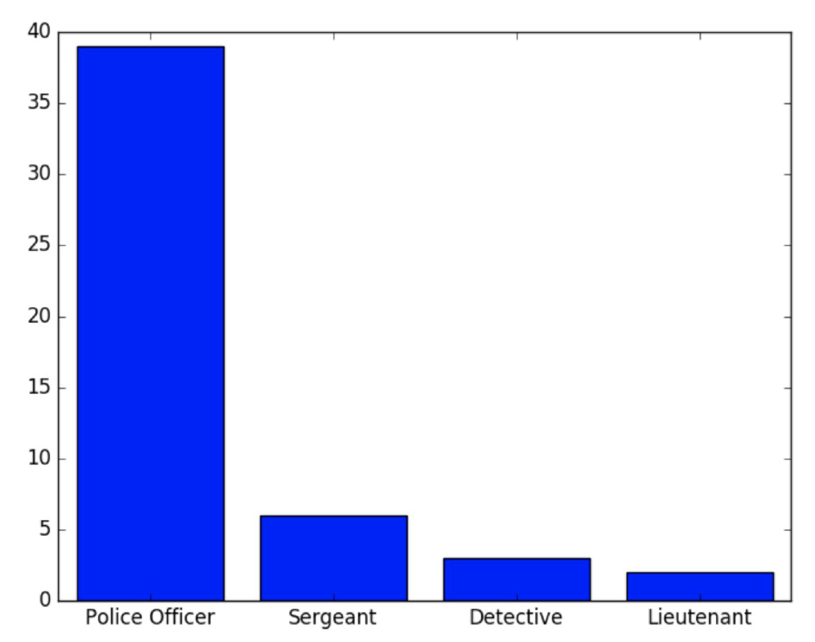
Graph Analytics: Officers linked based on same allegation category (After 2015)
Top 50 officers (by pagerank) segregated by rank
Normalized count:
Police officer = 39/61 = 0.639
Sergeant =6/22 = 0.2727
Detective = 3/8 = 0.375
Lieutenant = 2/3 = 0.66
Notes:
Lieutenant and Police Officers have higher count

Slide 35
Machine Learning
We are creating a ML model to flag officers based on the data before 2015. This model will be tested on data from 2015 onwards.
Secondly, we will be creating a ML model which predicts the number of complaints an officer will accrue in upcoming years.

Slide 36
Natural Language Processing
We will be using a N-gram model to group similar words from all documents. This will be done separately for date before 2015 and after 2015.
Developing a model to give a “severity measure” to each document and then analyzing whether the average severity has decreased after 2015.

Slide 37
Impact of CPDB
Shifted attention from isolated failures like Mcdonald shooting to a history of systematic failures
Was instrumental in firing of Superintendent Garry McCarthy
Our analysis showed that the release of CPDB has had a positive impact - Punishments are getting stricter, cases are getting settled faster.
However, the relative factors and distribution was seen to remain the same in both cases
Notes:
http://hillmanfoundation.org/sidney-awards/invisible-institute-wins-december-sidney-exposing-trove-troubling-police-data

Slide 38
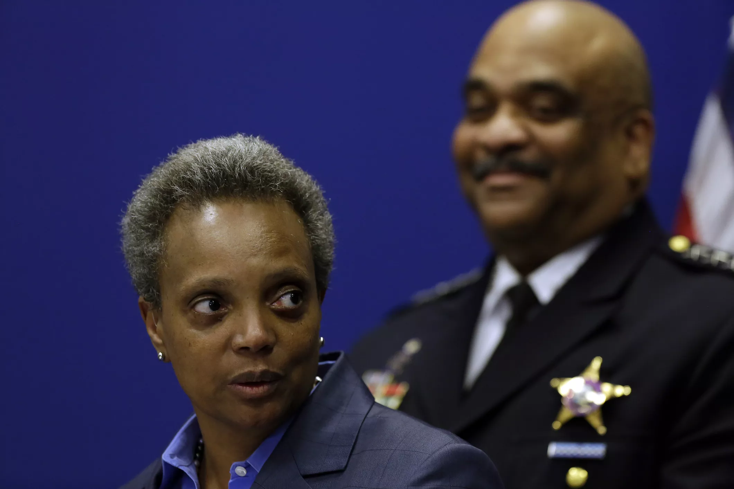
The present
Mayor Lori fired Superintendent Eddie Johnson
Currently, more officers are in process of being fired
The CPD missed 37 out of 50 deadlines of the consent decree but completed its obligations in the end.

